Slide 1
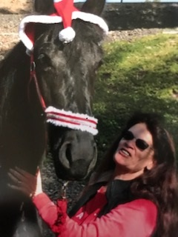
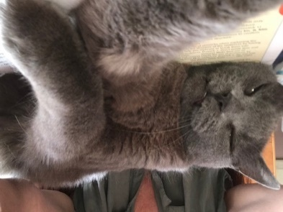
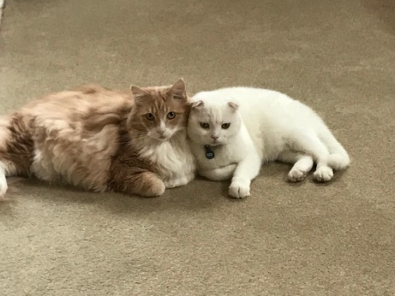
Mrs. Marsh
Hi Scholars!
I am Mrs. Marsh. My husband and I live in Thousand Oaks with our 3 cats, Maxx, Kahn, and Storm. I have a lovely horse named Dia who lives at a barn in Thousand Oaks. We compete in Dressage. I love to travel and have made trips to England, Germany, France, and most recently, Ireland and Scotland. I am so excited about our new adventure this year! We are going to have a FANTASTIC time!
Email
lmarsh@pvsdcamarillo.org
Phone
805-383-5355
Horses!! Cats!!
Reading
Purple, Starbucks, Rainy days, Outdoors, Netflix,
Essential oils
Dodgers

