Slide 1
Standards BASED Grading and NEw Report card
SBG is a model of grading which uses a rubric system
(1, 2, 3) and is based solely on what students know and are able to do in relation to the standard.
Standards are listed on the report card
Data recording sheets

Slide 2
Level 3
The student can independently and consistently demonstrate proficiency of the standard. The student is on grade level.
If the reporting period mark is a 3, the student has mastered grade level standards and meets the grade-level expectations for that marking period.

Slide 3
Level 2
The student cannot independently demonstrate the skill or standard consistently and teacher/adult support and assistance are needed. The student is approaching mastery, but performing inconsistently.
Level 2 says “meeting basic standards”.
If a 2 is given as a final mark, the student is not mastering the standard independently. The student will need some additional practice, support, and opportunities to demonstrate mastery of the standard.

Slide 4
Level 1
The student cannot either independently or with support demonstrate the skills of the standard. This student is an emerging and developing learner.
If a 1 is given as a final mark, the student is not mastering grade level standards and most marks over the course of the grading period are 1s.
This student will need additional support, practice, and a variety of instructional strategies to foster academic growth.

Slide 5
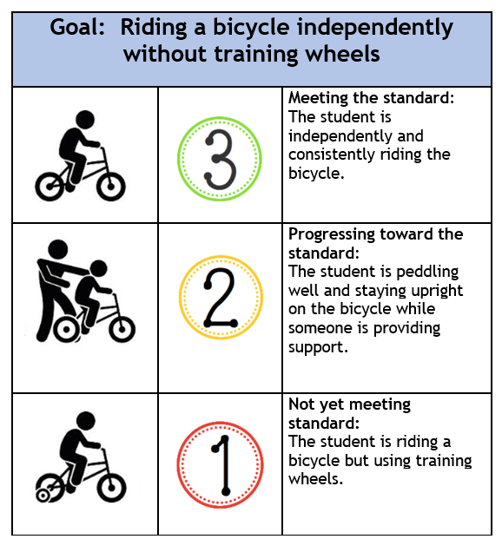

Slide 6
The Rubric in kid friendly language
Level 3 - I’ve got it.
Level 2 - I need some help with this.
Level 1 - I just don’t get it.

Slide 7
Some things to keep in mind...
Standards-based marks are not averaged, but rather seen as a progression of student learning. Where is the student in relation to the expectation of the grade-level standard
Multiple standards can be taught and assessed in a lesson.
With SBG the focus is on what we want students to know and be able to do now (by trimester) as they work toward grade level proficiency by the end of the school year (proficiency rubric).
Students are not penalized for the time it takes them to learn the skills of the standard.

